Slide 1

SALES ANALYSIS
BY KEERTHI

Slide 2

OBJECTIVE
To provide accurate management information relating to sales activity in order to improve sales profitability and product facilities for sales forecasting and planning at customer and product class levels.

Slide 3

DATABASE DESCRIPTION
CUSTOMER | PRODUCTS | PINCODE | DELIVERY PERSON | ORDER
Cust _ id First _ name Last _ name Email Phone Primary _ pin code Gender Dob Joining _ date | Product _ id Product _ name Brand Category Procurement _ cost _ per _ unit MRP | Pin code State city | Delivery _ person _ id Name Joining _ date Pin code | Order _ id, Order _ type Cust _ id Order _ date Delivery _ date tot _ units Displayed _ selling _p rice_ per _ unit Total _ amount _ paid Product _ id Delivery _ person _ id payment _ type delivery_ pin code

Slide 4

1. How many customers do not have DOB information available?
OUTPUT:

Slide 5
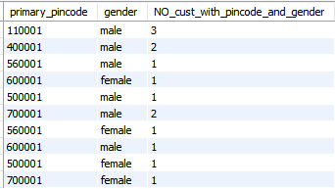
2. How many customers are there in each pin code and gender combination?
OUTPUT:

Slide 6

3. Print product name and MRP for products which have more than 50000 MRP?
OUTPUT:

Slide 7
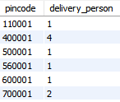
4. How many delivery person are there in each pin code?
OUTPUT:

Slide 8
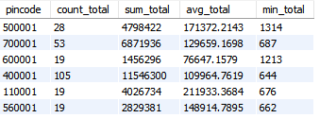
5. For each Pin code, print the count of orders, sum of total amount paid, average amount paid, maximum amount paid, minimum amount paid for the transactions which were paid by 'cash’. Take only 'buy' order types
OUTPUT:

Slide 9
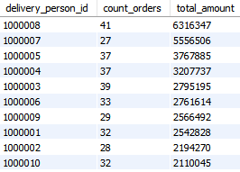
6. For each delivery _ person _ id, print the count of orders and total amount paid for product _ id = 12350 or 12348 and total units > 8. Sort the output by total amount paid in descending order. Take only 'buy' order types
OUTPUT:

Slide 10

7. Print the Full names (first name plus last name) for customers that have email on“ g mail. com"?
OUTPUT:

Slide 11

8. Which pin code has average amount paid more than 150,000? Take only 'buy' order types
OUTPUT:

Slide 12
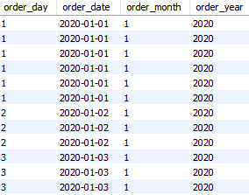
9. Create following columns from order _ dim data order date, order day ,order month , order year
OUTPUT:

Slide 13
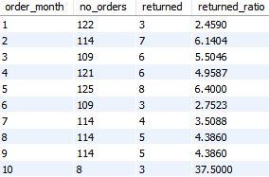
10. How many total orders were there in each month and how many of them were returned? Add a column for return rate too.
OUTPUT:

Slide 14

11. How many units have been sold by each brand? Also get total returned units for each brand.
OUTPUT:

Slide 15
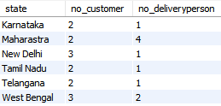
12. How many distinct customers and delivery boys are there in each state?
OUTPUT:

Slide 16
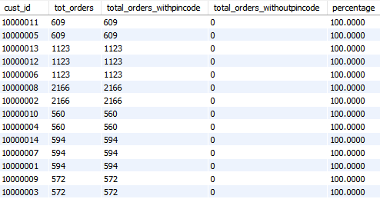
13. For every customer, print how many total units were ordered, how many units were ordered from their primary pin code and how many were ordered not from the primary pin code. Also calculate the percentage of total units which were ordered from primary pin code Sort by the age column in desc
OUTPUT:

Slide 17
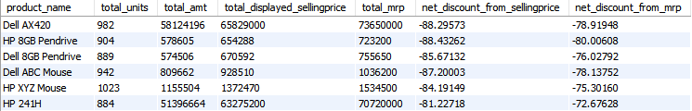
14. For each product name, print the sum of number of units, total amount paid, total displayed selling price, total MRP of these units, and finally the net discount from selling price.
OUTPUT:

Slide 18
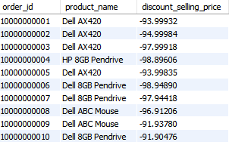
15. For every order id (exclude returns), get the product name and calculate the discount percentage from selling price. Sort by highest discount and print only those rows where discount percentage was above 10.10%
OUTPUT:

Slide 19

16. Using the per unit procurement cost in product dim, find which product category has made the most profit in both absolute amount and percentage
OUTPUT:

Slide 20
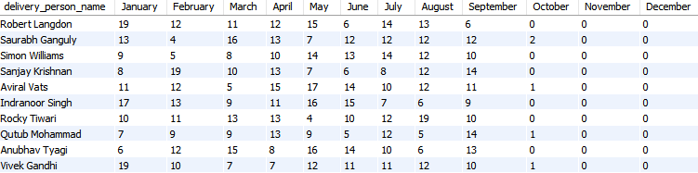
17. For every delivery person(use their name), print the total number of order ids by month in separate columns i.e. there should be one row for each delivery person id and 12 columns for every month in the year
OUTPUT:

Slide 21

18. For each gender - male and female - find the absolute and percentage
OUTPUT:

Slide 22
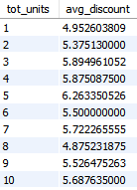
19. Generally the more numbers of units you buy, the more discount seller will give you. For 'Dell AX420' is there a relationship between number of units ordered and average discount from selling price? Take only 'buy' order types
OUTPUT:

Slide 23


WHAT I DID
BASIC SQL
SQL JOINS
ADVANCED SQL

Slide 24

THANK YOU!

